Slide 1
Map Understanding
Jialin Li
Sep 14, 2020
Notes:
Hi everyone, I am going to briefly introduce the project about map understanding I’m doing.

Slide 2
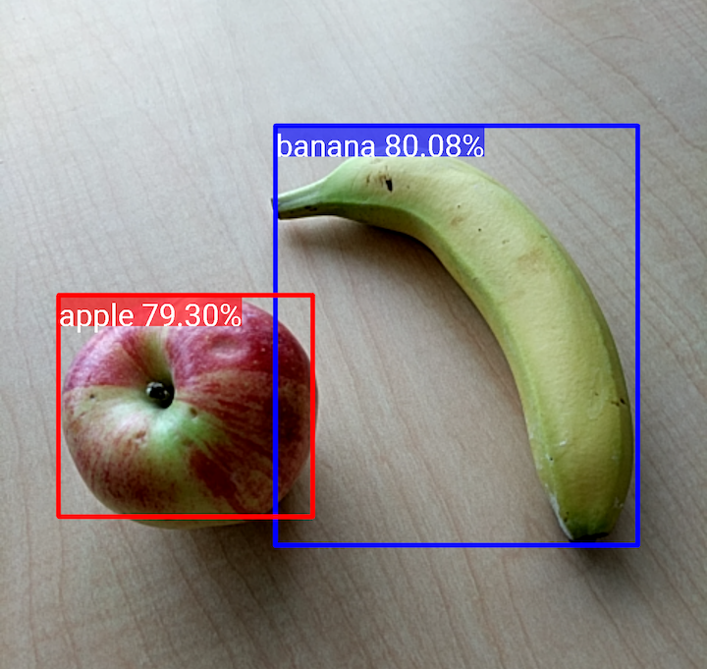
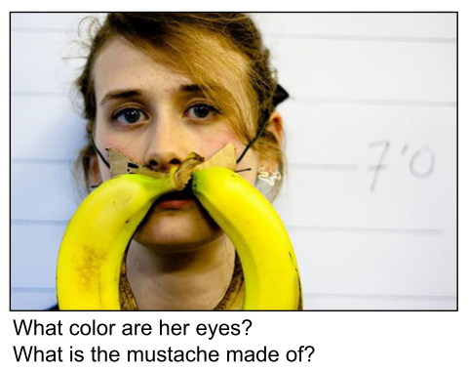

Introduction
The evolution of machine learning prompts new trends of machine learning and AI applications in many fields, e.g., computer vision
Image classification
Object detection
VQA
Notes:
In the past years…
In many fields, for example, in computer vision, there are applications in image classification, object detection and VQA.
These developments make our research possible to understand maps.

Slide 3
Map Understanding
Basic information identification
Given any image, is it a map, if it is, which geographic region the map is about, and what projection is used in this map?
Used SVM, MLP, and CNN to identify basic information
Semantic analysis (Choropleth map)
Where are the map elements, such as map title and legend, in choropleth map?
What is the topic of the map and what is the legend categories?
Which region in the map has the largest attribute value?
Focus on choropleth maps for the U.S. in state level
Notes:
I divided the big research question of map understanding into two subtasks. The first one is for my phd research in geography and the second task is mainly for my master research in computer science. In the first part,…

Slide 4
Applications
Practical applications
Help blind or vision-impaired people to learn the information from map images
Image adding and retrieval from large image database
Notes:
There are several practical applications of the map understanding research, for example….
For the application fields in CS, it can be regarded as a part of image captioning, image summary, VQA for map images, and data mining for maps

Slide 5
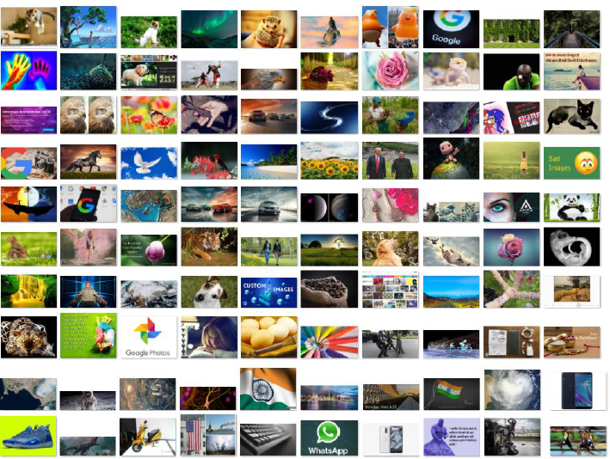
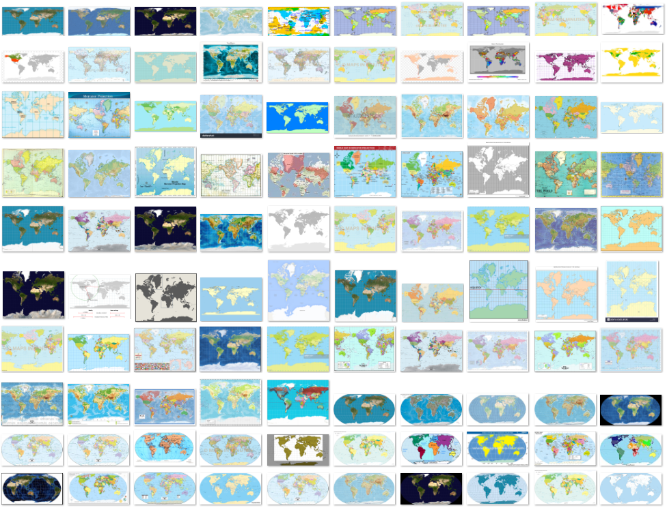
Data: Map/non-map Identification
Two classes: non-map (500) and map (500)
Notes:
I would like to briefly introduce the work and results I did for basic information identification. To answer the three questions, we used images like this…

Slide 6
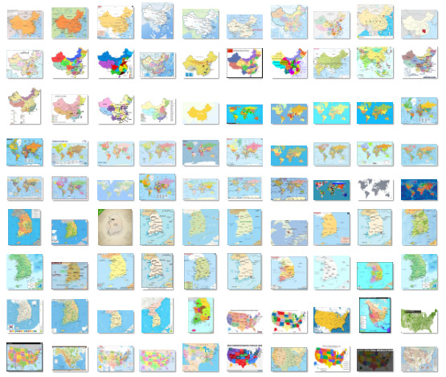
Data: Region Identification
Five classes: China, the U.S., South Korea, the World, others
250 images for each
Notes:
For region classification, 250 maps for each of four regions are collected.

Slide 7
Data: Projection Identification
Five classes: Equirectangular, Mercator, Equal-area, Robinson, and other projection (250 images for each)
Notes:
As for projection classification, because it is really hard to find world maps with the same projection online…
Check the properties of projections.

Slide 8
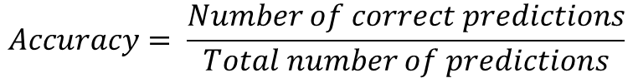
Results for Basic Information Identification
$$Accuracy= \frac{Number of correct predictions}{Total number of predictions}$$
Tasks | Testing Accuracy (%)
Map identification | 98.5
Region identification | 96.5
Projection identification | 94.0
Notes:
We mainly use classification accuracy to evaluate the results.
Accuracy is calculated by dividing the number of correct predictions by the total number of predictions
The best testing accuracy we got for the three tasks are shown here, as we can see, they are above 90%, which is pretty good.

Slide 9
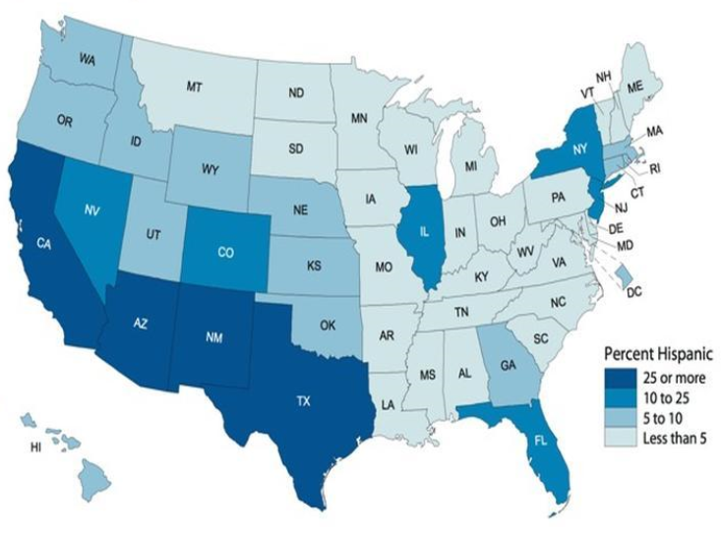
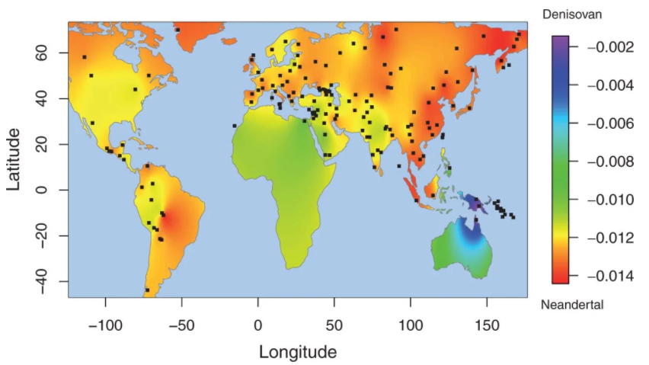
Choropleth Map
A common type of areal quantitative thematic map
The units on a choropleth map are distinguished from other units by various colors, shades or patterns that indicate the numerical value of the phenomenon in each unit
Heat map
Choropleth map
Notes:
In the second part, semantic analysis for map understanding, we focus on choropleth maps of the US in state level.

Slide 10
Semantic Analysis Framework
Choropleth map images
(collected & generated)
Attribute related questions
Spatial related questions
Shapefile of the US
Text recognition
(OCR)
Extract topic et al
(NER)
Map element detection
Legend analysis
Spatial relation analysis
State detection
(template matching)
Both attribute and spatial related questions
Notes:
The framework for semantic analysis is shown here.
For the image data we want to use in our research is collected and generated images…

Slide 11
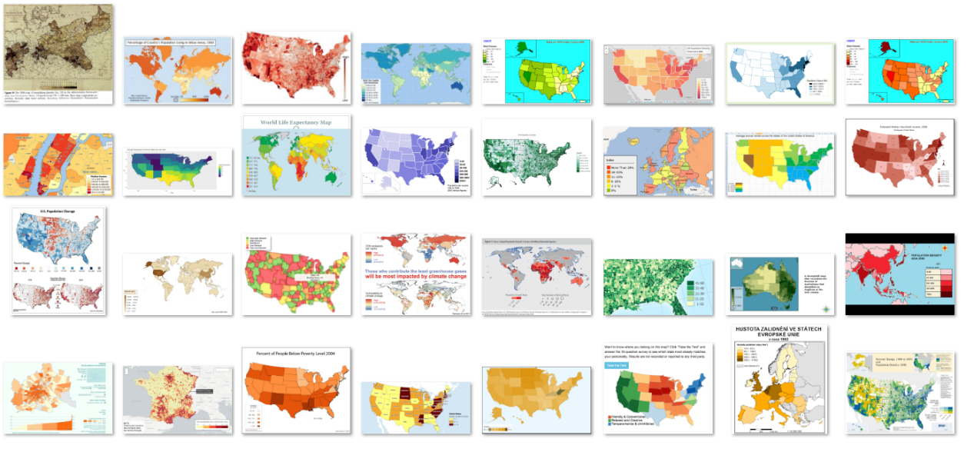
Data Preparation
Collected images
889 real map images from online resources in total
Include 114 US choropleth maps in state level

Slide 12
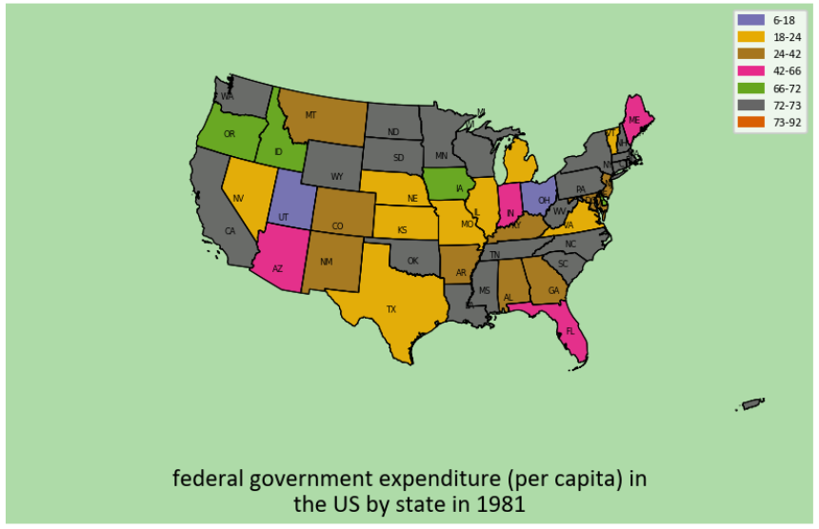
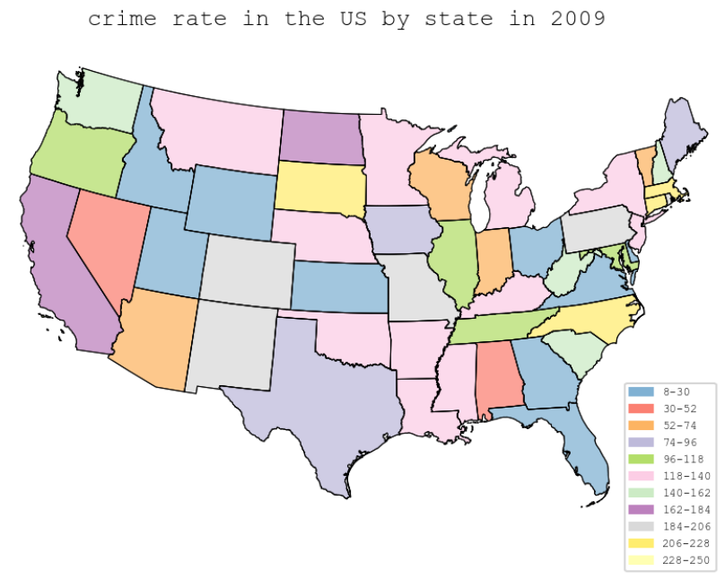
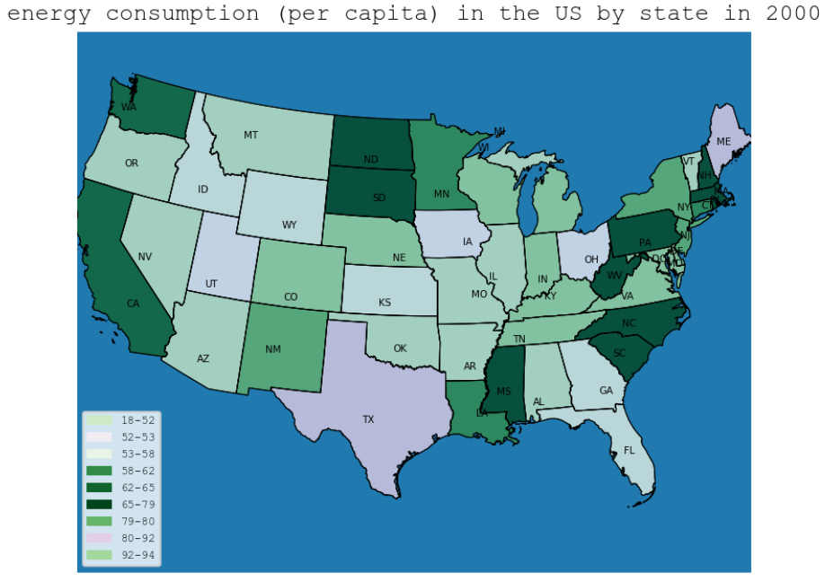
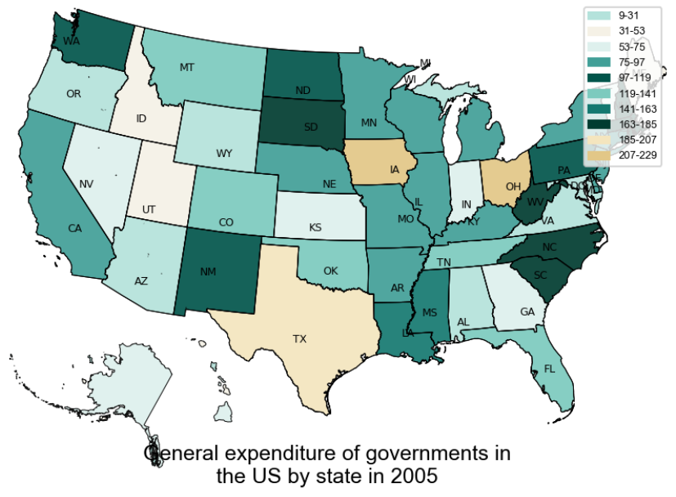
Data Preparation
Generated images (500 image for now)
Use several dimensions of variations (such as color, size, title)
Theme + (geographic region) + time + (administration level)

Slide 13
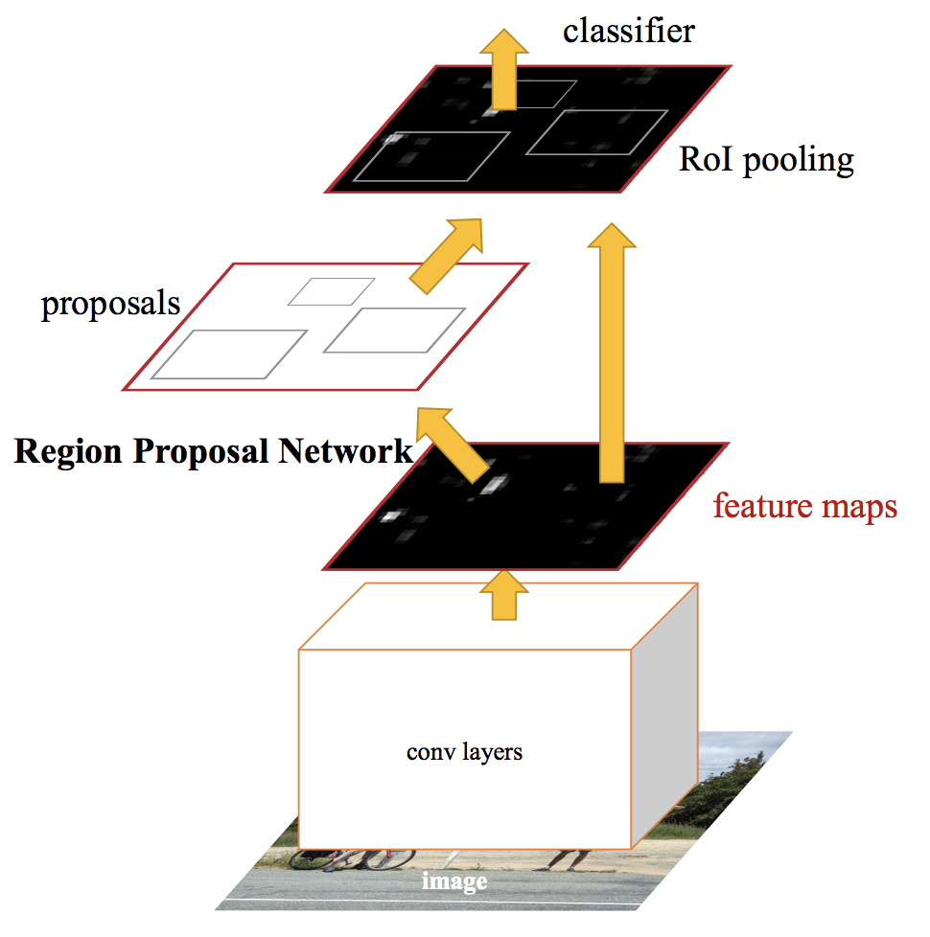
Map Element Detection
Faster R-CNN
Introduces a Region Proposal Network (RPN) to propose candidate regions
RPN shares convolutional features with the detection network, enabling nearly cost-free region proposals
(Source: Ren et al., 2017, Faster R-CNN: Towards Real-Time Object Detection with Region Proposal Networks)
Notes:
For the methods to detect map elements, we compared Faster R-CNN and YOLOv3.

Slide 14
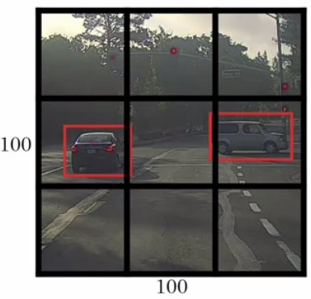
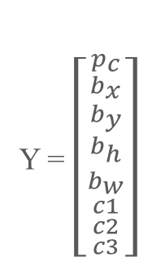
Map Element Detection
YOLO (You Only Look Once)
Y = $\left[{{{p_{c} \atop b_{x}} \atop {b_{y} \atop b_{h}}} \atop {{b_{w} \atop c1} \atop {c2 \atop c3}}}\right]$
Object Classes:
1 – pedestrian
2 – car
3 – motorcycle
Divides the image into regions and predicts bounding boxes and probabilities for each region simultaneously
A single neural network to predict the size and location of bounding boxes and class probabilities directly from full images in one evaluation
(Image Source: https://www.coursera.org/learn/convolutional-neural-networks
Notes:
YOLO is the first one-stage object detection model.

Slide 15
Results: Map Element Detection
Finetuned Faster R-CNN and YOLOv3 based on labeled image data
Use average precision (AP) and mAP to evaluate detection results
Evaluation Metrics | Fine-tuned Faster R-CNN | Fine-tuned YOLOv3
AP title | 0.55 | 0.69
AP legend | 0.72 | 0.80
mAP | 0.64 | 0.75
Notes:
We finetuned the two pretrained models based on labeled map images, and use a
This is the results for map element detection.

Slide 16
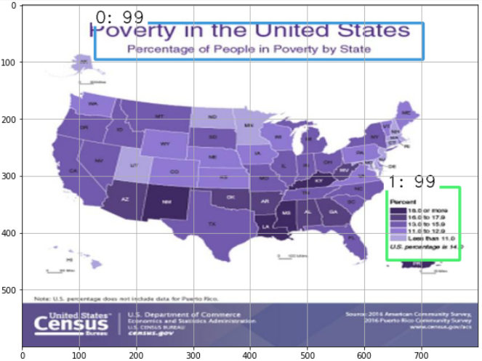
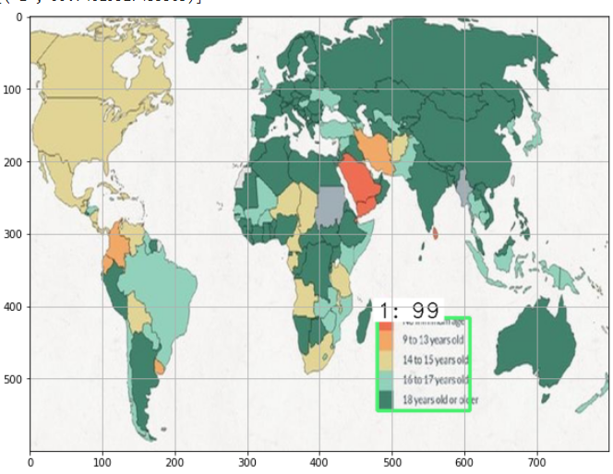
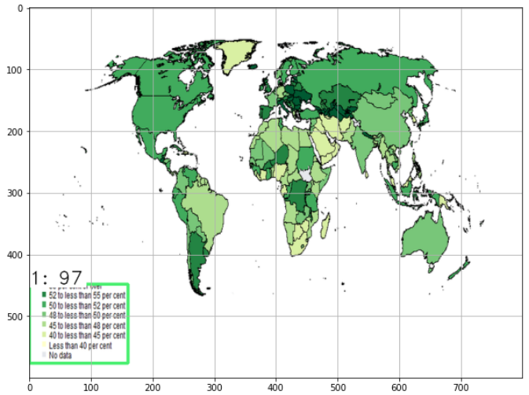
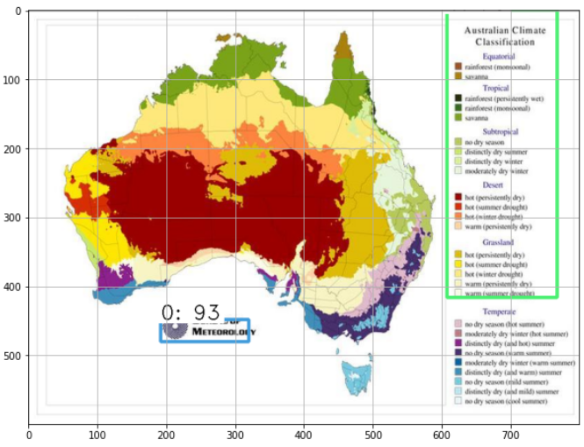
Results: Map Element Detection
Notes:
Some of the detected results are shown here.

Slide 17
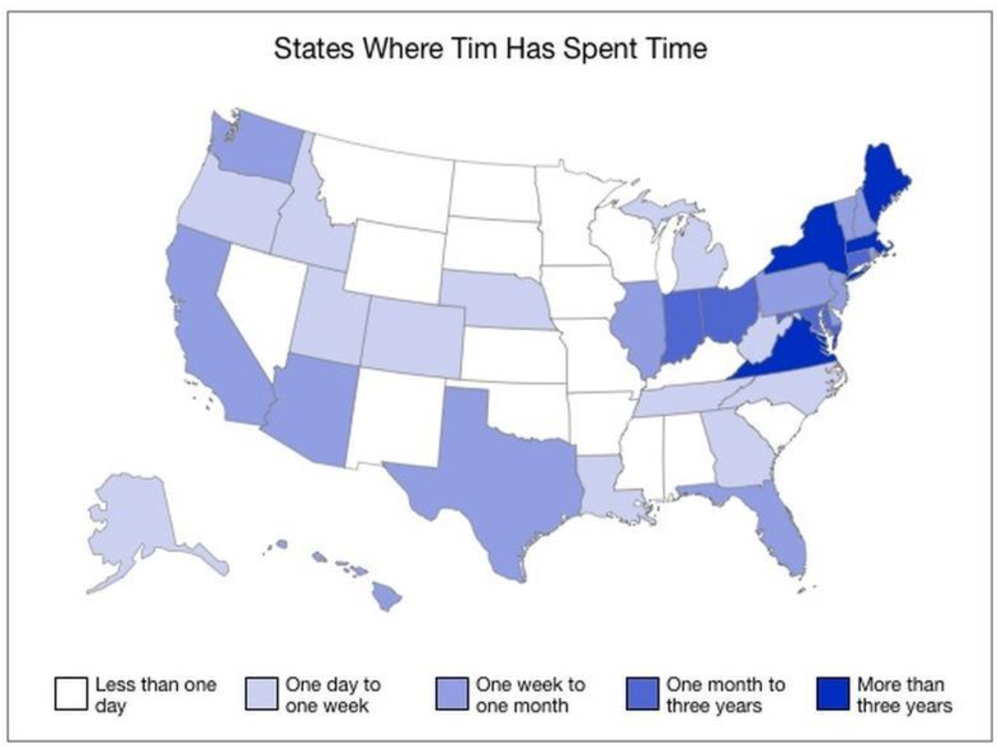
Text Recognition
easyOCR library: recognize texts in title and legend area
[([[220, 28], [568, 28], [568, 56], [220, 56]], 'States Where Tim Has Spent Time', 0.32365480065345764), ([[229, 534], [309, 534], [309, 553], [229, 553]], 'One dayto', 0.4850400686264038), ([[381, 535], [471, 535], [471, 553], [381, 553]], 'One week tO', 0.11245011538267136), ([[531, 535], [629, 535], [629, 553], [531, 553]], 'One monih to', 0.254203736782074), ([[681, 535], [753, 535], [753, 553], [681, 553]], 'More tnan', 0.38105398416519165) , ([[81, 537], [181, 537], [181, 553], [81, 553]], 'Less than one', 0.5371154546737671), ([[678, 548], [762, 548], [762, 572], [678, 572]], 'three years', 0.4762100577354431), ([[81.02871413764274, 550.2516854477569], [110.84803366484378, 554.2352964145474], [107.97128586235726, 571.7483145522431], [78.15196633515622, 567.7647035854526]], 'day', 0.5481166243553162), ([[531, 551], [611, 551], [611, 571], [531, 571]], 'three years', 0.858946681022644), ([[231, 553], [301, 553], [301, 569], [231, 569]], 'one wsek', 0.23274843394756317), ([[381, 553], [457, 553], [457, 569], [381, 569]], 'one month', 0.3442462086677551)]

Slide 18
Theme Extraction
Conduct NER on recognized title texts
Generate titles: Theme, Region, Admin Level, Time
Add a new label "THEME", and train the model using spaCy
Entities in 'By state Average percent of time engaged in Vehicles in South Korea in 2004 '
THEME Average percent of time engaged in Vehicles
Entities in 'In 1964 Household income '
THEME Household income
Entities in 'By census tract in France in 1972 Household income '
THEME Household income
Entities in 'By township in 1969 Estimated annual sales for Electronics & appliance stores '
THEME Estimated annual sales for Electronics & appliance stores

Slide 19
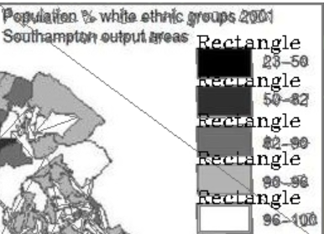
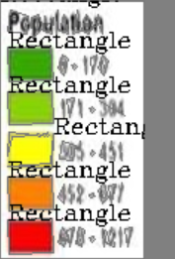
Legend Analysis
Image enhancement before recognizing color boxes and texts to increase contrast and sharpness
Rectangle\polygon detection using opencv library to recognize symbols for legend categories
Match detected polygons and texts in legend area based on their position

Slide 20
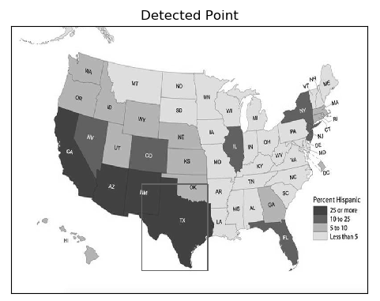
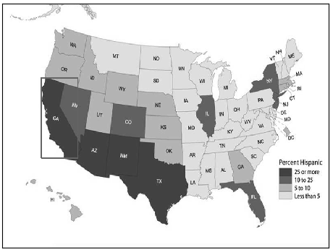

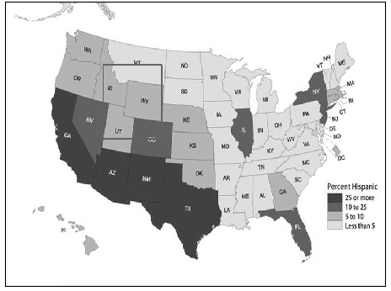
State Detection
Conduct template matching to detect states (using normed correlation coefficient)
10 templates for 10 states now

Slide 21
Spatial Relationship Analysis
OGR (OpenGIS simple feature reference implementation): a component of GDAL (Geospatial Data Abstraction Library)
Adjacency
Orientation
Identify the relation between two states
Identify the states with a relation with one state
May also be asked together with attribute related questions

Slide 22
More work to do
Image summary or image captioning: generate a summary of choropleth map images
VQA for maps:
How to understand questions for a choropleth map,
Based on the understanding, how to utilize the modules to extract semantic information from choropleth maps
Generating answers for questions
More types of maps can be explored
Proportional symbol maps
Small multiples and change maps (identify changes of geographic features)

Slide 23
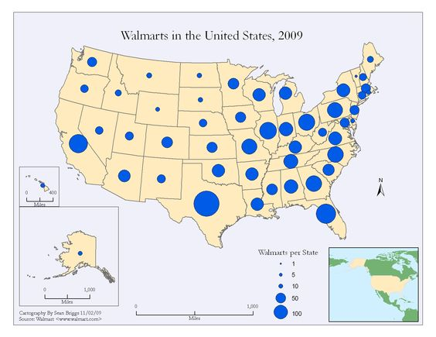
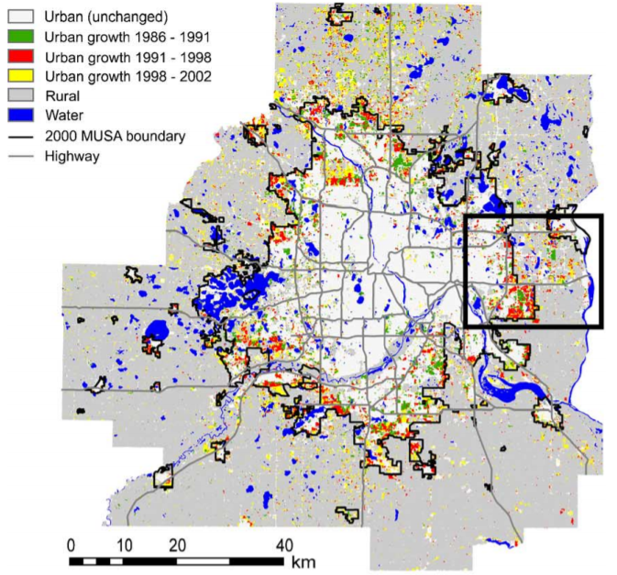
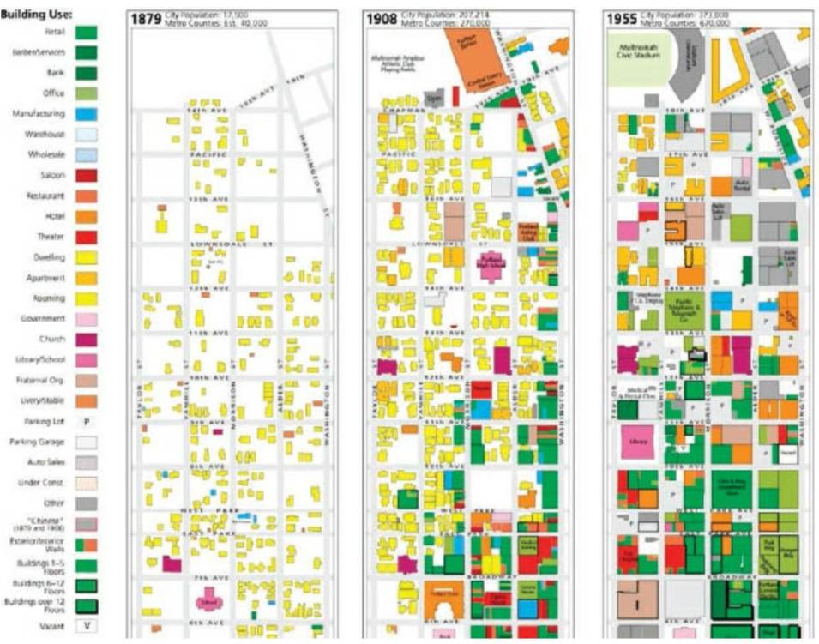
More work to do

